Slide 1
Project 1: Interim Presentation Treatment Responses to HAART in Multicenter AIDS Cohort Study
Rachel Johnson
BIOS 6623

Slide 2
Data Summary
Research question:
How do treatment responses after 2 years differ between subjects who report using hard drugs and those who didn’t?
Primary predictor
Hard drug use at baseline (Yes (n = 467) vs. No (n = 39))
Covariates selected by investigator
Baseline: age, BMI, alcohol use (13 or fewer vs. >13 drinks), smoking status (never/former vs. current), income level (<$10,000, $10,000-$40,000, >$40,000), education (HS degree or less, >HS degree)
2 year: ART adherence (>95% vs. <95%)

Slide 3
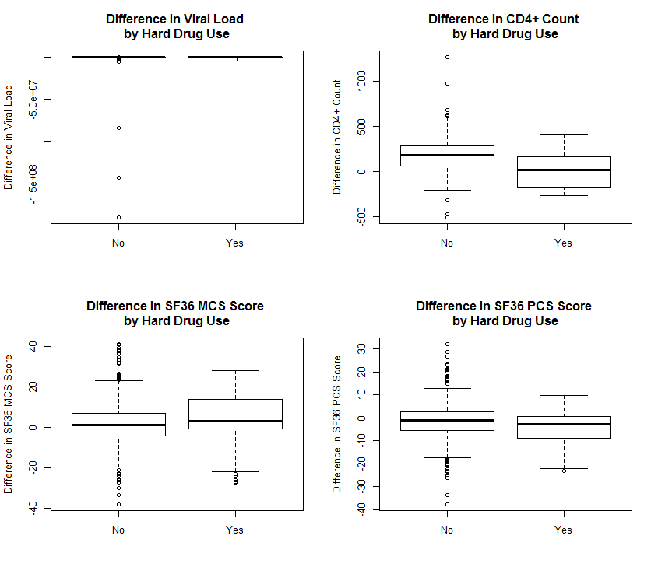

Slide 4
Data Analysis Plan & Questions
Outcomes
Laboratory: Viral load, CD4+ count
Quality of Life: SF36 MCS score, SC36 PCS score
Proposed primary outcome: CD4+ because normally distributed, few outliers, proven to be clinically relevant in HIV+ population
Model plan
Hybrid model (difference as outcome, adjust for baseline)
Bayesian approach to analysis
Questions
Outliers in viral load--what are feasible values for this variable?
If you could only analyze one outcome, what would you pick?
Do you only want to include subjects with outcomes for all 4 outcomes?

